Slide 1
11. Performance
1.1–1.2
Notes:
Learning Objectives
(11.1a) Explain algorithmic efficiency as it relates to speed and space consumption.
(11.1b) Recognize typical orders of complexity (O(1), O(log n), O(n), O(n log n), O(n^2), O(n^3), O(2^n))
(11.1c) Identify the basic operations in an algorithm and determine the running time of an algorithm by counting its basic operations.
(11.1d) Express the running time of an algorithm as a function of the input size and derive the complexity class of the algorithm.
(11.1e) Categorize algorithms according to their Big O complexity.
(11.1f) Describe space and time efficiency tradeoffs when designing algorithms.
(11.1g) Identify the best case, worst case, and average case Big O complexities of algorithms.
(11.1h) Compare the efficiencies of different algorithms that perform the same task.

Slide 2
11. Performance
The challenge
Empirical analysis
Mathematical models
Doubling method
Familiar examples
Adopted and modified from Slides by Sedgewick and Wayne

Slide 3

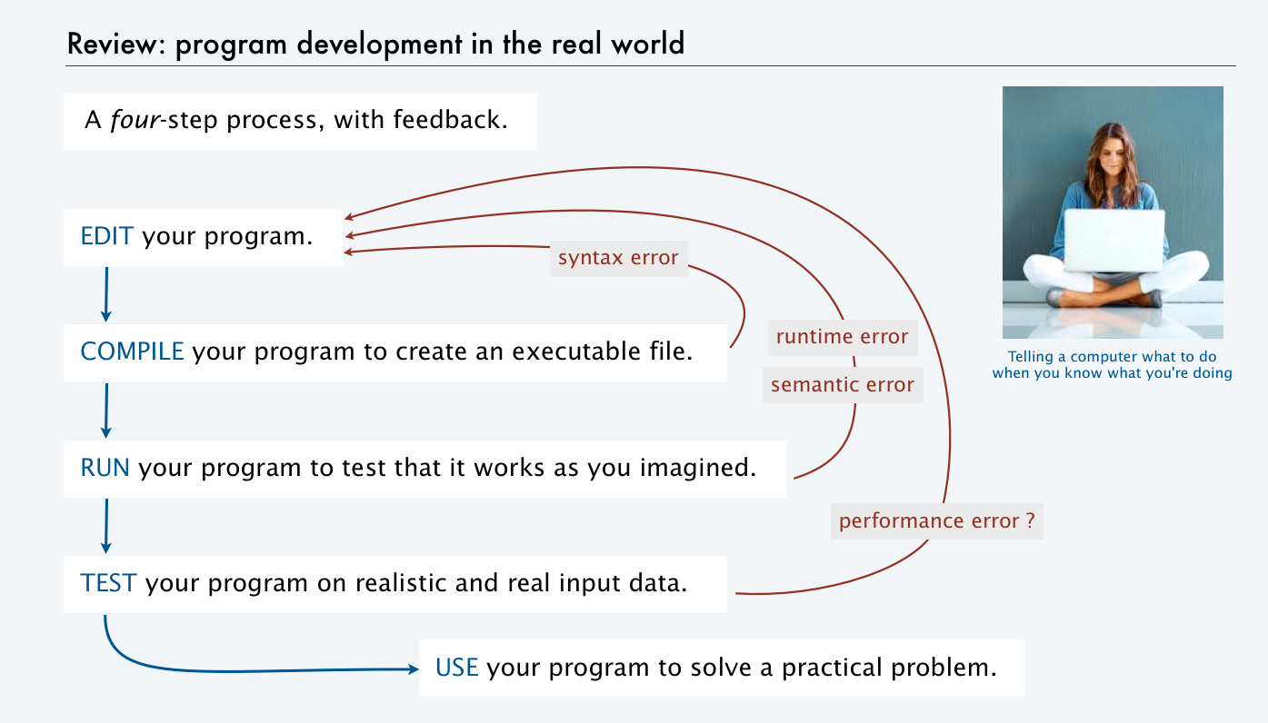
The challenge (modern version)
Q. Will I be able to use my program to solve a large practical problem?
Q. If not, how might I understand its performance characteristics so as to improve it?
Key insight (Knuth 1970s). Use the scientific method to understand performance.

Slide 4

Three reasons to study program performance
public class Gambler
{
public static void main(String[] args)
{
int stake = Integer.parseInt(args[0]);
int goal = Integer.parseInt(args[1]);
int trials = Integer.parseInt(args[2]);
int wins = 0;
for (int t = 0; t < trials; t++)
{
int cash = stake;
while (cash > 0 && cash < goal)
if (Math.random() < 0.5) cash++; else cash--;
if (cash == goal) wins++;
}
StdOut.print(wins + " wins of " + trials);
}
}
1. To predict program behavior
Will my program finish?
When will my program finish?
2. To compare algorithms and implementations.
Will this change make my program faster?
How can I make my program faster?
3. To develop a basis for understanding the problem and for designing new algorithms
Enables new technology.
Enables new research.
An algorithm is a method for solving a problem that is suitable for implementation as a computer program.
We study several algorithms later in this course. Taking more CS courses? You'll learn dozens of algorithms.
Notes:
Analysis of algorithms. Framework for comparing algorithms and predicting performance.

Slide 5
Travel
Suppose you want to go to a store downtown. Which is best?
Walk
Drive your car
Ask a friend to take you
Take a bus
What does best mean?
Fastest?
How do you decide?
Measure cost (distance, speed, traffic, parking, etc.)

Slide 6
How To Compare Algorithms?
There are a plethora of algorithms to perform the same task. Which one to choose?
How to know which algorithm performs better, meaning more efficient?
Usually, we consider time, space, generality, programming effort, etc.

Slide 7
Efficiency and Complexity of Algorithms
Measuring Complexity of Algorithms is called ANALYSIS of ALGORITHMS.
Efficiency is a measure of speed and space consumption
Speed – time complexity
also called running or execution time
denoted by the letter O (Big O)
Space consumption – space complexity
also represented using Big O
always less than or equal to the time requirement
Note that if you revise an algorithm to reduce space requirement, you may increase time requirement

Slide 8
Efficiency of Algorithms
How to measure?
how fast a program takes to run depends on computer architecture, language, compiler, programmer
instead of running a program to measure its efficiency we analyze it
Running time is determined by two factors: the cost of executing each statement and the frequency of execution of each statement.
Translation: Count the number of operations!!!
Notes:
To measure running time count the number of operations that are most often executed

Slide 9
Efficiency of Algorithms
Find a function of the problem size that behaves like the algorithm's actual time requirement.
Does the number of statements executed in a program grow with the size of the input (e.g. search for the last element in an array)
the input size is used to describe the running time
Translation: Count the number of operations!!!
Remember the Pseudocode examples we did!!!
Remember the count of operations in a loop:
int sum = 0;
for(int i = 0; i < n; i++){
sum += i;
}
Notes:
To measure running time count the number of operations that are most often executed

Slide 10
Efficiency of Algorithms
Identify the basic operations in an algorithm
Determine the running time of an algorithm by counting its basic operations
Express the running time of an algorithm as a function of the input size
Derive the Complexity Class of an algorithm
Big Oh order of the running time—we’ll get to this!

Slide 11
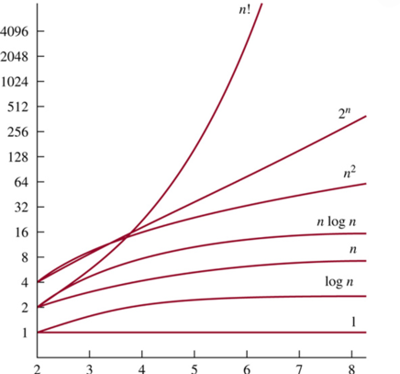
Complexity Classes –Big O Complexity Chart
Algorithm 2 O(n²)
Algorithm 1 O(n)
Algorithm 3 O(1)

Slide 12
Example—compute the sum 1 + 2 + … + n, n > 0 English (not Java) Carrano – Data Structures and Abstractions
Algorithm 1
sum = 0;
for i = 1 to n
sum = sum + i
1 + 2 + 3 + …+ n
Algorithm 2
sum = 0;
for i = 1 to n
for j = 1 to i
sum = sum + 1
1 + (1 + 1) + (1 + 1 + 1) + .. (1 + 1 +…+1)
Algorithm 3
sum = n * ( n + 1 ) / 2

Slide 13
Algorithm 1 – number of operations - English (not Java)
Assignments | 1 + n
Additions, multiplications, divisions | n
Total Operations | (n + 1) + n = 2n + 1 = O(n)
sum = 0;
for i = 1 to n
sum = sum + i;
1 + 2 + 3 + …+ n
The big picture….not looking at real code…just thinking!!!

Slide 14
Algorithm 2 – number of operations – English (not Java)
sum = 0;
for i = 1 to n
for j = 1 to i
sum = sum + 1
1 + (1 + 1) + (1 + 1 + 1) + .. (1 + 1 + … +1)
Note: 1 + 2 + 3 + … + n = n*(n+1)/2
Assignments | 1 + n * (n + 1) / 2
Additions, multiplications, divisions | n * (n + 1) / 2
Total Operations | 1 + n * (n + 1) = n² + n + 1 = O(n²)
inner
The big picture….not looking at real code…just thinking!!!

Slide 15
Algorithm 3 – number of operations
Assignments | 1
Additions, multiplications, divisions | 3
Total Operations | 4 = O(1)
sum = n * ( n + 1 ) / 2

Slide 16
Summary:
 | Algorithm 1 | Algorithm 2 | Algorithm 3
Assignments | n + 1 | 1 + n * (n + 1) / 2 | 1
Additions, multiplications, divisions | n | n * (n + 1) / 2 | 3
Total Operations | n + (n + 1) = 2n + 1 | 1 + n * (n + 1) = n² + n + 1 | 4
Big O Notation | O(n) | O(n²) | O(1)

Slide 17
Hints….
Different steps get added
Drop Constants
Drop non-dominant terms

Slide 18
Complexity Classes –Big O Complexity Chart
Algorithm 2 O(n²)
Algorithm 1 O(n)
Algorithm 3 O(1)

Slide 19
Asymptotic Complexity
Asymptotic analysis is a method of describing a limiting behavior
The O notation asymptotically bounds a function
estimate the complexity in asymptotic sense, i.e. estimate the complexity of a function for arbitrarily large inputs

Slide 20
Identifying Operations
We use just a few primitive operations to implement algorithms
statements, conditionals, loops, nesting and method calls
We will assume it takes constant time to execute one statement
int a = 1 + 45; O(1)
int b = 67 * 375665; O(1)
System.out.println(a); O(1)
if (a == b) O(1)

Slide 21
O(1)
public boolean IsFirstElementNull(String[] arr) {
return (arr[0] == null);
}
O(1) describes an algorithm that will always execute in the same time (or space) regardless of the size of the input data set.

Slide 22
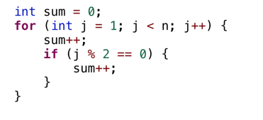
From Practice It.
init= 1
loop→ init = 1;
test = (n- 1) + 1;
increment = n – 1
sum→ n – 1
if→ n – 1
sum in if→ (n-1) / 2
//these are in the general case
Big O?????
O(n)
Notes:
Init = 1
Loop = 1 + n + n-1 (init, test, increment)
Sum = n-1
If n-1
Sum++ (could be 0; (n-1)/2→

Slide 23
Hints….
Different steps get added
Drop Constants
Drop non-dominant terms

Slide 24
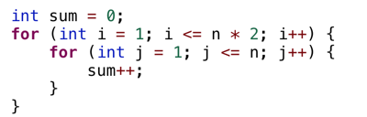
From Practice It.
Init→1
Outer→1(init) + 2n+1 (test) + 2n (inc)
Inner--> 1(init) + n+1 (test) + n (inc)
//for each iteration of outer loop
Sum++→ n
//for each iteration of outer loop
O(n²)
1 + 1 + 2n+1 + 2n + ( 1 + (n+1) + n ) * 2n + (2n*n)
Outer loop inner loop sum
Notes:
Init = 1
Outer loop" 1 + (2n + 1) + 2n
Inner loop = (1 + (n+1) + n) * 2n
Sum++ = 2n * n
1 + 2n+1 + 2n + 1 + n+1 + n + 2n*n = 2n^2 + 6n + 4

Slide 25
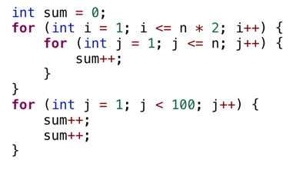
From Practice It.
Notes:
N^2

Slide 26
Hints….
Different steps get added
Drop Constants
Drop non-dominant terms

Slide 27
Sequential Search
Searching an unordered array
How to find a target value?
check each element in sequence
3 | 5 | 12 | 2 | 56 | 32 | 8 | 14
0 | 1 | 2 | 3 | 4 | 5 | 6 | 7 | 8 | 9
Array index
int SequencialSearch (int[] array, int n, int target) {
for (int i = 0; i < n; i++) {
if (array[i] == target) {
return i;
}
}
return -1;
}
Loop mechanics
Algorithm Basic Operation
Notes:
More often than not, we will need to analyze the running time of an algorithm BEFORE we even implement it (we may need to explore choices, analyze each, pick best, THEN implement)
Which means we will count ONLY operations that are characteristic of the algorithm (looping mechanism is implementation specific)
Ignoring looping mechanism does NOT change the Big O (stands to reason because looping mechanism is just supporting scaffolding to execute the algorithm, so it cannot supersede the algorithm’s running time.)

Slide 28
Sequential Search: Efficiency Analysis
Check each element in sequence to find the target
3 | 5 | 12 | 2 | 56 | 32 | 8 | 14
0 | 1 | 2 | 3 | 4 | 5 | 6 | 7 | 8 | 9
Array index
Scenarios
Best case
which number is fastest to find (requires the least number of comparisons)?
Worst case
which number is the longest to find (requires the largest number of comparisons)?
Average case
average all possibilities (takes into account the probability of a possibility)

Slide 29
Sequential Search: Efficiency Analysis
Operation | Time cost | How many (success or failure))
Initializing i | 1 | 1
Compare i against array length | 1 | Best: 1 Worst: n+1
Incrementing i | 1 | Best: 0 Worst: n
Comparing target against array entry | 1 | Best: 1 Worst: n
Does not change with input length:
Loop mechanics time:
Algorithm time:
int SequentialSearch (int[] array, int n, int target) {
for (int i = 0; i < n; i++) {
if (array[i] == target) {
return i;
}
}
return -1;
Notes:
Express the running time of an algorithm as a function of the input size.
Now, we have to derive the big O for this function.
But what is big O?

Slide 30
Sequential Search: Efficiency Analysis
Operation | Time cost | How many (success or failure))
Initializing i | 1 | 1
Compare i against array length | 1 | Best: 1 Worst: n + 1
Incrementing i | 1 | Best: 0 Worst: n
Comparing target against array entry | 1 | Best: 1 Worst: n
Does not change with input length:
Loop mechanics time:
Algorithm time:
int SequentialSearch (int[] array, int n, int target) {
for (int i = 0; i < n; i++) {
if (array[i] == target) {
return i;
}
}
return -1;
Running time function
Best case: f(n) = 1 + 1 = 2 = O(1)
Worst case: f(n) = n + 1 + n + n = 3n + 1 = O(n)
Notes:
Express the running time of an algorithm as a function of the input size.
Now, we have to derive the big O for this function.
But what is big O?

Slide 31
Efficiency of a Sequential Search
Best case O(1)
Locate desired item first
Worst case O(n)
Must look at all the items
Average case O(n)
Must look at half the items
O(n/2) is still O(n)

Slide 32
Analyze the Algorithm (Big O?---For you to do)
Problem 1
for (int i = 1; i <= n; i++){
for (int j = 1; j <= 5; j++){
sum += 1;
}
}
Notes:
Inner O(1); Outer O(n) = O(n)

Slide 33
Analyze the Algorithm (Big O?---For you to do)
Problem 2
for (i = 0; i < n; i++) {
sequence of statements
}
for (j = 0; j < m; j++) {
sequence of statements
}
Problem 3
What if n = m?
Notes:
2. Since you don't know which is bigger, you say this is O(N+M). This can also be written as O(max(n,m))
3. What if n = m? O(N+M) becomes O(2N) and when you drop the constant it is O(N)

Slide 34
Analyze the Algorithm (Big O?---For you to do)
Problem 4
for (i = 0; i < n; i++) {
for (j = 0; j <n; j++) {
sequence of statements
}
}
for (k = 0; k < n; k++) {
sequence of statements
}
Notes:
O(n^2) + O(n) = O(n^2)

Slide 35
Analyze the Algorithm (Big O?---For you to do)
Problem 5
for (i = 0; i < n; i++) {
for (j = n; j > i; j--)
{ sequence of statements
}
}
Notes:
Inner loop → n + n – 1 + n – 2 + .,..+ 0. = n ( n+1)/2
t is still the case that the inner loop executes N times, then N-1, then N-2, etc, so the total number of times the innermost "sequence of statements" executes is O(N²).

Slide 36
An algorithm is written to remove the first element from an array of n integers and shift all other elements to the left one position. Big O? Explain.
An algorithm to remove all negative values from an array of n integers sequentially examines each element in the array. When a negative is value is found, all elements to the right of the negative value are moved one position to the left in the list. Big O is? Explain.
Problem 6
Problem 7
Notes:
No negatives—O(n)
All negatives O(n²)

Slide 37
Analyze the Algorithm
Problem 8
You are at a wedding reception and seated at a table with n people.
In prep of a toast, the waiter pours champagne into each of n glasses.
Someone makes a toast.
You click your glass with everyone at the table.
Everyone else at your table does the same.
Efficiency? Big Oh?
Notes:
(N-1) FOR EACH PERSON
MUST NOT COUNT 1→2 AND 2→1
ANSWER = (N-1) * N /2
O(N²)

Slide 38
An algorithmic challenge: 3-sum problem Files: in folder ThreeSumProblem
Three-sum. Given N integers, enumerate the triples that sum to 0.
For simplicity, just count them.
public class ThreeSum
{
public static int count(int[] a)
{ /* See next slide. */ }
public static void main(String[] args)
{
int[] a = StdIn.readAllInts();
StdOut.println(count(a));
}
}
Applications in computational geometry
Find collinear points.
Does one polygon fit inside another?
Robot motion planning.
[a surprisingly long list]
% more 6ints.txt
30 -30 -20 -10 40 0
% java ThreeSum < 6ints.txt
3
✗
30 | -30 | 0
30 | -20 | -10
-30 | -10 | 40
✗
Q. Can we solve this problem for N = 1 million?
✓
Notes:
Suggestion: Run this program on command line to see how much we can increase the value of N.

Slide 39

Three-sum implementation
"Brute force" algorithm
Process all possible triples.
Increment counter when sum is 0.
i | j | k | a[i] | a[j] | a[k]
0 | 1 | 2 | 30 | -30 | -20
0 | 1 | 3 | 30 | -30 | -10
0 | 1 | 4 | 30 | -30 | 40
0 | 1 | 5 | 30 | -30 | 0
0 | 2 | 3 | 30 | -20 | -10
0 | 2 | 4 | 30 | -20 | 40
0 | 2 | 5 | 30 | -20 | 0
0 | 3 | 4 | 30 | -10 | 40
0 | 3 | 5 | 30 | -10 | 0
0 | 4 | 5 | 30 | 40 | 0
1 | 2 | 3 | -30 | -20 | -10
1 | 2 | 4 | -30 | -20 | 40
1 | 2 | 5 | -30 | -20 | 0
1 | 3 | 4 | -30 | -10 | 40
1 | 3 | 5 | -30 | -10 | 0
1 | 4 | 5 | -30 | 40 | 0
2 | 3 | 4 | -20 | -10 | 40
2 | 3 | 5 | -20 | -10 | 0
2 | 4 | 5 | -20 | 40 | 0
3 | 4 | 5 | -10 | 40 | 0
i | 0 | 1 | 2 | 3 | 4 | 5
a[i] | 30 | -30 | -20 | -10 | 40 | 0
public static int count(int[] a)
{
int N = a.length;
int cnt = 0;
for (int i = 0; i < N; i++)
for (int j = i+1; j < N; j++)
for (int k = j+1; k < N; k++)
if (a[i] + a[j] + a[k] == 0)
cnt++;
return cnt;
}
Keep i < j < k to avoid processing each triple 6 times
triples with i < j < k
Q. How much time will this program take for N = 1 million?
Notes:
good style to declare loop iteration variable in initialization statement.
Example of automatic type conversion from integer to string.
Suggestion: Run this program on a terminal command line to see how much you can increase N

Slide 40
An algorithmic challenge: 3-sum problem (with timing)
Explain algorithmic efficiency as it relates to speed and space consumption.
LO 11.1a
Three-sum. Given N random integers, enumerate the triples that sum to 0.
N | time
10
100
import java.util.Random();
public class ThreeSum
{
public static int count(int[] a)
{ /* See previous slide. */ }
public static void main(String[] args)
{
int N = Integer.parseInt(args[0]);
int[] a = new int[N];
Random r = new Random();
for (int i=0; i< N; i++)
a[i] = r.nextInt()
StdOut.println(count(a));
}
}
% java ThreeSum 10000
1000
10000
1000000
ThreeSum2.java (Timer added)
Stopwatch.java
10⁹ | ??
10¹² | ??
10¹⁵ | ??
Q. Complete the table for N=10, 100, 1000, … not sure you want to do this.
Notes:
(11.1a) Explain algorithmic efficiency as it relates to speed and space consumption.
Suggestion: Run this program on command line to see how much we can increase the value of N.

Slide 41
Memory usage by a program
Explain algorithmic efficiency as it relates to speed and space consumption.
LO 11.1a
Memory. It is possible to count how much memory might be used by a program.
public static int[ ] reverse(int[ ] a) {
int n = a.length;
for (int i=0; i< a.length/2; i++) {
int tmp = a[i];
a[i] = a[n-i-1];
a[n-i-1] = tmp;
}
return a;
}
Q. Assuming ints are 4 bytes, what is the total memory requirement for reverse function?
A. 4n + 4 + 4 + 4 = 4n + 12
Notes:
(11.1a) Explain algorithmic efficiency as it relates to speed and space consumption.
Suggestion: Run this program on command line to see how much we can increase the value of N.
4n (array of n ints) + 4 (n) + 4(i) + 4 (tmp)

Slide 42
7. Performance
The challenge
Empirical analysis
Mathematical models
Doubling method
Familiar examples

Slide 43
A first step in analyzing running time
Find representative inputs
Option 1: Collect actual input data.
Option 2: Write a program to generate representative inputs.
Input generator for ThreeSum
% java Generator 1000000 10
28773
-807569
-425582
594752
600579
-483784
-861312
-690436
-732636
360294
public class Generator
{ // Generate N integers in [-M, M)
public static void main(String[] args)
{
int M = Integer.parseInt(args[0]);
int N = Integer.parseInt(args[1]);
for (int i = 0; i < N; i++)
StdOut.println(StdRandom.uniform(-M, M));
}
}
% java Generator 10 10
-2
1
-4
1
-2
-10
-4
1
0
-7
not much chance
of a 3-sum
good chance
of a 3-sum

Slide 44
Empirical analysis
Run experiments
Start with a moderate input size N.
Measure and record running time.
Double input size N.
Repeat.
Tabulate and plot results.
Replace println() in ThreeSum with this code.
Measure running time
double start = System.currentTimeMillis() / 1000.0;
int cnt = count(a);
double now = System.currentTimeMillis() / 1000.0;
StdOut.printf("%d (%.0f seconds)\n", cnt, now - start);
Tabulate and plot results
Run experiments
250
N | time (seconds)
1000 | 0
2000 | 4
4000 | 31
8000 | 248
% java Generator 1000000 1000 | java ThreeSum
59 (0 seconds)
% java Generator 1000000 2000 | java ThreeSum
522 (4 seconds)
% java Generator 1000000 4000 | java ThreeSum
3992 (31 seconds)
% java Generator 1000000 8000 | java ThreeSum
31903 (248 seconds)
200
time (seconds)
100
0
0 | 1000 | 2000 |  | 4000 |  |  |  | 8000
problem size (N)

Slide 45
7. Performance
The challenge
Empirical analysis
Mathematical models
Doubling method
Familiar examples

Slide 46
Warmup: 1-sum
Identify the basic operations in an algorithm and determine the running time of an algorithm by counting its basic operations.
LO 11.1c
public static int count(int[] a)
{
int N = a.length;
int cnt = 0;
for (int i = 0; i < N; i++)
if (a[i] == 0)
cnt++;
return cnt;
}
operation | cost | frequency
function call/return | 20 ns | 1
variable declaration | 2 ns | 2
assignment | 1 ns | 2
less than compare | 1/2 ns | N + 1
equal to compare | 1/2 ns | N
array access | 1/2 ns | N
increment | 1/2 ns | between N and 2N
Note that frequency of increments
depends on input.
representative estimates (with some poetic license);
knowing exact values may require study and experimentation.
Q. Formula for total running time ?
A. cN + 26.5 nanoseconds, where c is between 2 and 2.5, depending on input.
Notes:
(11.1c) Identify the basic operations in an algorithm and determine the running time of an algorithm by counting its basic operations.
consider putting in instruction counts for N = 10000

Slide 47
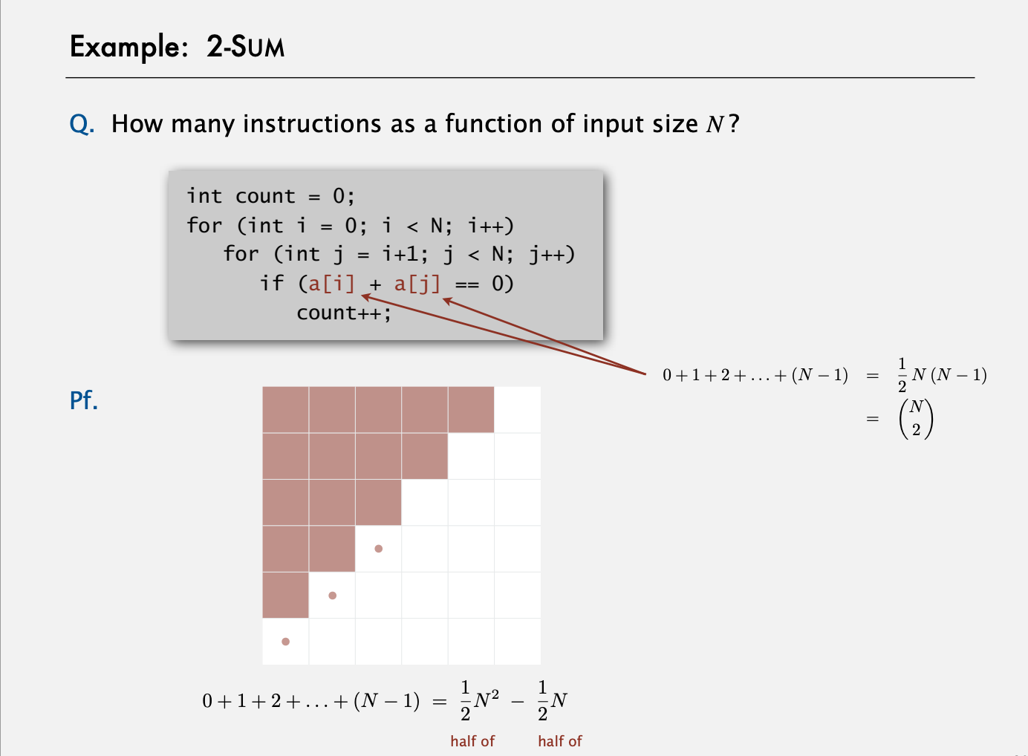
Let N = 6
Notes:
(First + last)* (number of terms)/2

Slide 48
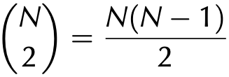
Warmup: 2-sum
operation | cost | frequency
function call/return | 20 ns | 1
variable declaration | 2 ns | N + 2
assignment | 1 ns | N + 2
less than compare | 1/2 ns | (N + 1) (N + 2)/2
equal to compare | 1/2 ns | N (N − 1)/2
array access | 1/2 ns | N (N − 1)
increment | 1/2 ns | between N (N + 1)/2 and N ²
public static int count(int[] a)
{
int N = a.length;
int cnt = 0;
for (int i = 0; i < N; i++)
for (int j = i+1; j < N; j++)
if (a[i] + a[j] == 0)
cnt++;
return cnt;
}
exact counts tedious to derive
# i < j =
Q. Formula for total running time ?
A. c1N² + c2N + c3 nanoseconds, where... [complicated definitions].
Notes:
consider putting in instruction counts for N = 10000

Slide 49
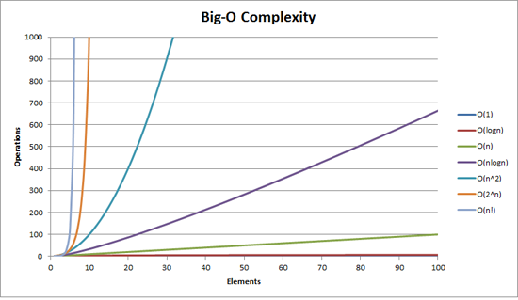
Comparing algorithms
Recognize typical orders of complexity (O(1), O(log n), O(n), O(n log n), O(n^2), O(n^3), O(2^n))
LO 11.1b
This Photo by Unknown Author is licensed under CC BY-SA
Q. Order algorithms from slowest to fastest
A. n! > 2^{n} > n^{n} > n log n > n > log n > 1
Notes:
(11.1b) Recognize typical orders of complexity (O(1), O(log n), O(n), O(n log n), O(n^2), O(n^3), O(2^n))

Slide 50
Classify Algorithms
LO 11.1e
Categorize algorithms according to their Big O complexity.
Q. Classify each of these algorithms using typical orders of complexity.
Algorithm. Find an element in a random array of N ints
N
Algorithm. Swap any two elements in an array of size N
1
Algorithm. Given N integers, find 3 integers that sums to zero
N³
Algorithm. Find an element in a sorted array of N ints
Log N
Algorithm. Given N elements, find all combinations
N!
Notes:
Categorize algorithms according to their Big O complexity.
consider putting in instruction counts for N = 10000

Slide 51
Counting basic operations
Identify the basic operations in an algorithm and determine the running time of an algorithm by counting its basic operations.
LO 11.1c
public static int count(int[] a)
{
int N = a.length;
int cnt = 0;
for (int i = 0; i < N; i++)
if (a[i] < 0)
cnt++;
return cnt;
}
1
1
1initialization, N+1 comparisons, N increments
N comparisons
0 to N increments
Q. What types of basic operations are performed in the code above?
A. Assignment (=) , comparison (<), increment (++)
Notes:
(11.1c) Identify the basic operations in an algorithm and determine the running time of an algorithm by counting its basic operations.

Slide 52
Counting operations
Express the running time of an algorithm as a function of the input size and derive the complexity class of the algorithm.
LO 11.1d
public static int count(int[] a)
{
int N = a.length;
int cnt = 0;
for (int i = 0; i < N; i++)
for (int j = i+1; j < N; j++)
if (a[i] + a[j] == 0)
cnt++;
return cnt;
}
Counting comparisons (==) operations (if statement)
i j operations
0 1….N-1 N-1
2…N-1 N-2
3…N-1 N-3
.
.
N-2 N-1..N-1 1
N-1 N..N-1 0
Total Comparisons = (N-1 ) + (N-2) + … + 2 + 1
~ N²
Running time is proportional to: N²
Complexity class of the algorithm: N²
Q. What types of basic operations are performed in the code above?
A. Assignment (=) , comparison (<, ==), addition (+)
increment (++)
Notes:
(11.1d) Express the running time of an algorithm as a function of the input size and derive the complexity class of the algorithm.
consider putting in instruction counts for N = 10000

Slide 53
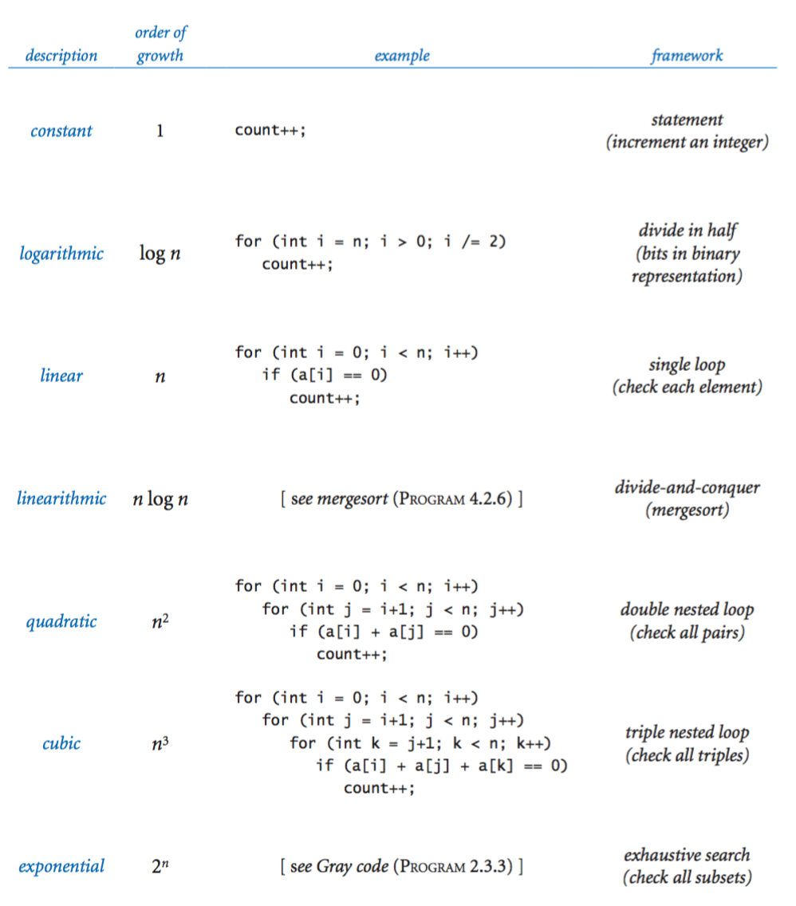
Common order-of-growth hypothesis
Categorize algorithms according to their Big O complexity.
LO 11.1e
Patterns. Look for specific framework to determine order-of-growth.
Notes:
(11.1e) Categorize algorithms according to their Big O complexity.
consider putting in instruction counts for N = 10000

Slide 54
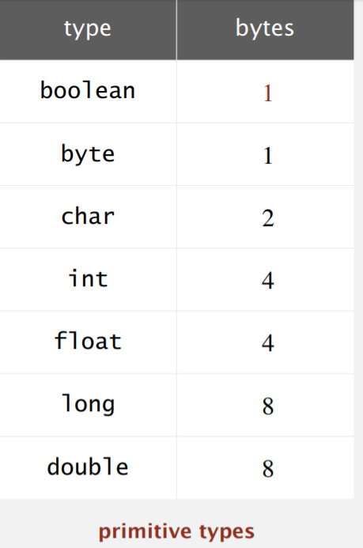
Time and space efficiency
Describe space and time efficiency tradeoffs when designing algorithms.
LO 11.1f
Time efficiency. How fast a program runs (on average)?
Space efficiency. How much memory is used by a program (on average)?
Typical memory used by primitive types
Notes:
(11.1f) Describe space and time efficiency tradeoffs when designing algorithms.
consider putting in instruction counts for N = 10000

Slide 55
Order of growth
Recognize typical orders of complexity (O(1), O(log n), O(n), O(n log n), O(n^2), O(n^3), O(2^n))
LO 11.1b
Hypothesis. The order of growth of the running time of my program is N^{b} (logN)^{c}.
log instead of lg
since constant base
not relevant
Evidence. Known to be true for many, many programs with simple and similar structure.
Linear (N)
Quadratic (N²)
Cubic (N³)
for (int i = 0; i < N; i++)
...
for (int i = 0; i < N; i++)
for (int j = i+1; j < N; j++)
for (int k = j+1; k < N; k++)
...
for (int i = 0; i < N; i++)
for (int j = i+1; j < N; j++)
...
Logarithmic (log N)
public static void f(int N)
{
if (N == 0) return;
... f(N/2)...
}
Linearithmic (N log N)
public static void f(int N)
{
if (N == 0) return;
... f(N/2)...
... f(N/2)...
for (int i = 0; i < N; i++)
...
}
Exponential (2^{N})
public static void f(int N)
{
if (N == 0) return;
... f(N-1)...
... f(N-1)...
}
Stay tuned for examples.
ignore for practical purposes (infeasible for large N )
Notes:
(11.1b) Recognize typical orders of complexity (O(1), O(log n), O(n), O(n log n), O(n^2), O(n^3), O(2^n))

Slide 56
Order of growth classifications
order of growth |  | slope of line in log-log plot (b) | factor for doubling method (2^{b})
description | function
constant | 1 | 0 | 1
logarithmic | logN | 0 | 1
linear | N | 1 | 2
linearithmic | N logN | 1 | 2
quadratic | N² | 2 | 4
cubic | N³ | 3 | 8
log-log plot
N³
N²
N
NlogN
Time
8T
4T
logN
2T
T
1
if input size doubles
running time increases
by this factor
 | 1K | 2K | 4K | 8K
Problem size
math model may
have log factor
If math model gives order of growth, use doubling method to validate 2^{b} ratio.
If not, use doubling method and solve for b = lg(TN/TN/2) to estimate order of growth to be N^{b}.

Slide 57
An important implication
Moore's Law. Computer power increases by a roughly a factor of 2 every 2 years.
Q. My problem size also doubles every 2 years. How much do I need to spend to get my job done?
a very common situation: weather prediction, transaction processing, cryptography...
 | now | 2 years from now | 4 years from now |  | 2M years from now
N | $X | $X | $X | ... | $X
N logN | $X | $X | $X | ... | $X
N² | $X | $2X | $4X | ... | $2^{M}X
N³ | $X | $4X | $16X | ... | $4^{M}X
Do the math
TN = aN³
running time today
T2N = (a/2)(2N)³
running time in 2 years
= 4aN³
= 4TN
A. You can't afford to use a quadratic algorithm (or worse) to address increasing problem sizes.

Slide 58
Summary
Use computational experiments, mathematical analysis, and the scientific method to learn whether your program might be useful to solve a large problem.
Q. What if it's not fast enough?
A.
does it scale?
yes
no
buy a new computer and solve bigger problems
learn a better algorithm
found one?
no
yes
invent a better algorithm
Plenty of new algorithms awaiting discovery.
Example: Solve 3-sum efficiently

Slide 59
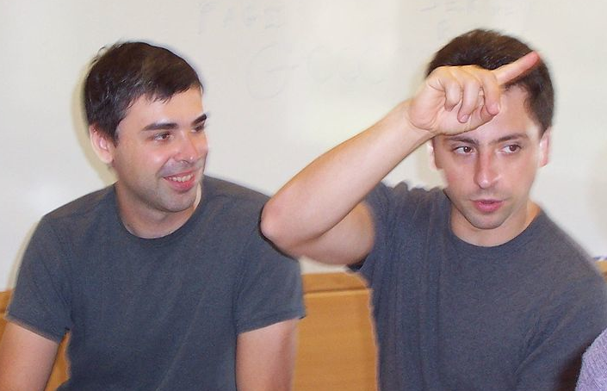


Case in point
Not so long ago, 2 CS grad students had a program to index and rank the web (to enable search).
does it scale?
yes
no
Larry Page and Sergey Brin
buy a new computer and solve bigger problems
learn a better algorithm
changing the world?
found one?
maybe
not yet
no
yes
PageRank (see Section 1.6)
yes
invent a better algorithm
Lesson. Performance matters!

Slide 60
Java ArrayList Class

Slide 61
Java ArrayList
As arrays an ArrayList also store large amounts of data in a single collection that can be referred to with a single variable.
The ArrayList class provides a dynamic array implementation
stores objects of the same type sequentially
grows as needed (double its size)
useful if the size of the array is unknown
implements the List interface
To declare an ArrayList
ArrayList <E> arrayReferenceVariable;
Item data type

Slide 62
Java ArrayList
An ArrayList implements the List interface
ArrayLists can only hold objects, and not primitive types such as ints.
Each element in the sequence can be accessed separately.
We can explicitly overwrite an object at a specified position in the sequence, thus changing its value.
We can inspect the object at a specified location in the sequence.
We can add an object into a specified position of the sequence.
We can add an object to the end of the sequence.
We can remove an object from a specified location in the sequence.

Slide 63
ArrayList operations
To declare and instantiate an ArrayList of Strings:
ArrayList<String> names = new ArrayList<String>();
int size()
returns the number of elements in this list
boolean add(x)
appends x to the end of list; returns true
void add(index, x)
inserts x at position index, sliding elements at position index and higher to the right. Adds 1 to their indices and adjusts size
E get(index)
returns the element at the specified position in this list.
E set(index, x)
replaces the element at index with x
returns the element formerly at the specified position
E remove(index)
removes element from position index, sliding subsequent elements to the left (subtracts 1 from their indices)
and adjusts size and returns the element at the specified position in this list.
E remove(obj)
removes element from position index, sliding subsequent elements to the left (subtracts 1 from their indices)
and adjusts size and returns the element at the specified position in this list.
int indexOf(obj)
If obj is found in the list, then the position number where it is found is returned.
If the obj is not found, then -1 is returned.

Slide 64
Array and ArrayList
0 | 1 | 2 | 3 | 4 | 5 | 6
5 | 7 | 2 | 9 | 4 | 3
Arrays are a fixed length.
ArrayLists grow and shrink as needed.
Arrays can hold primitive values or objects.
ArrayLists hold objects.
Copy items from index 3 to index 5 to the right => shift right
0 | 1 | 2 | 3 | 4 | 5 | 6
5 | 7 | 2 | 9 | 9 | 4 | 3
 | Array | ArrayList | Best case | Worst case
Can access each element separately | arr[i] | list.get(i); | O(1) | O(1)
Can explicitly overwrite an element in a specific position | arr[i] = "Tom"; | list.set(i,"Tom"); | O(1) | O(1)
Can add an object into a specified position in the sequence | If there is space, copy items i…length-1 to the right, then insert object into position i | list.add(i,”Joe”); | O(1) | O(n)
Can add an object to the end | If there is space, add object at the end (must keep track of last added element) | list.add("Joe"); | O(1) | O(n)
Can remove an object from a specified location | Copy items (i+1)…(length-1) to the left. Remove last element. | list.remove(i); | O(1) | O(n)

Slide 65
An example (What's printed?)
public static void main(String[] args){
ArrayList <String> names = new ArrayList<String>();
names.add("Ann");
names.add("Robert");
names.add("Tim");
names.add(1,"Michael");
names.add(3,"Susan");
printList(names);
names.remove(2);
printList(names);
names.set(2,"Lenny");
printList(names);
System.out.println("The name in position 1 is :" + names.get(1));
}

Slide 66
An example (What’s happening?)
public static void main(String[] args){
ArrayList<String> names = new ArrayList<String>();
names.add("Ann"); // Ann
names.add("Robert"); // Ann Robert
names.add("Tim"); // Ann Robert Tim
names.add(1,"Michael"); // Ann Michael Robert Tim
names.add(3,"Susan"); // Ann Michael Robert Susan Tim
System.out.println(names); // [Ann,Michael,Robert,Susan,Tim]
names.remove(2); // Ann Michael Susan Tim
System.out.println (names); // [Ann,Michael,Susan,Tim]
names.set(2,"Lenny"); // Ann Michael Lenny Tim
System.out.println (names); // [Ann, Michael, Lenny,Tim]
System.out.println("The name in position 1 is : " + names.get(1));
} // The name in position 1 is : Michael

Slide 67
An example
System.out.println("ArrayListTest");
ArrayList<String> aList = new ArrayList<String>();
aList.add("Dan");
aList.add("George");
aList.add("Mary");
System.out.println("aList contains:");
for(int x = 0; x < aList.size(); x++){
System.out.println(aList.get(x));
}
ArrayListTest
aList contains:
Dan
George
Mary
System.out.println(aList)
for(String e : aList){
System.out.println(e);
}

Slide 68
Another Example:
ArrayList<String> students = new ArrayList<String>();
students.add("Mary");
students.add("James");
students.add("Kevin");
students.add(1, "Tanya");
String temp = students.get(3);
System.out.println(temp);
students.remove(2);
students.set(1, "John");
System.out.println(students.size());

Slide 69
What happens?
Mary
James
Kevin
ArrayList<String> students = new ArrayList<String>();
students.add("Mary");
students.add("James");
students.add("Kevin");
students.add(1, "Tanya");
String temp = students.get(3);
System.out.println(temp);
students.remove(2);
students.set(1, "John");
students
Mary
Tanya
James
Kevin
students
temp
Mary
Tanya
Kevin
students
Mary
John
Kevin
students

Slide 70
ArrayLists can hold any kind of object.
ArrayList<Athlete> team = new ArrayList<Athlete>();
ArrayList<Student> cs111 = new ArrayList<Student>();
ArrayList<BankAccount> accounts = new
ArrayList<BankAccount> ();
ArrayLists DO NOT hold primitives.
But Java "wraps" primitives! (Don't worry about this yet-112)
ArrayList<Integer> nums = new
ArrayList<Integer> ();

Slide 71
Reminder about number of elements
Data Type | Number of Elements
Array | a.length
ArrayList | a.size()
String | a.length()

Slide 72
Array and Array List Manipulations:
Access elements
Traverse arrays
Find the maximum/minimum value --ARRAYS
Accumulate values -- ARRAYS
Work with consecutive terms
Add an element
Remove an element

Slide 73
Arrays and ArrayLists
The appropriate data structure:
Arrays are a fixed length.
ArrayLists grow and shrink as needed.
Arrays can hold primitive values or objects.
ArrayLists hold objects.

Slide 74
Arrays and Array Lists
Selecting the appropriate data structure:
 | Arrays | ArrayList
Can access each element separately | arr[i] | list.get(i)
Can explicitly overwrite an element in a specific position | arr[i] = "Tom"; | list.set(i,"Tom");
Can inspect the object at a specified location in the sequence | if arr[i]... | if list.get(i)...

Slide 75
Arrays and ArrayLists
Selecting the appropriate data structure:
 | Arrays | ArrayList
Can add an object into a specified position of the sequence | Lots of work | list.add(i,"Joe");
Can add an object to the end. | Only if there is room and you are keeping track of what and where you are adding. | list.add("Joe");
Can remove an object from a specified location | Lots of work | list.remove(i);

Slide 76
Array and ArrayList
0 | 1 | 2 | 3 | 4 | 5 | 6
5 | 7 | 2 | 9 | 4 | 3
Arrays are a fixed length.
ArrayLists grow and shrink as needed.
Arrays can hold primitive values or objects.
ArrayLists hold objects.
Copy items from index 3 to index 5 to the right => shift right
0 | 1 | 2 | 3 | 4 | 5 | 6
5 | 7 | 2 | 9 | 9 | 4 | 3
 | Array | ArrayList | Best case | Worst case
Can access each element separately | arr[i] | list.get(i); | O(1) | O(1)
Can explicitly overwrite an element in a specific position | arr[i] = "Tom"; | list.set(i,"Tom"); | O(1) | O(1)
Can add an object into a specified position in the sequence | If there is space, copy items i…length-1 to the right, then insert object into position i | list.add(i,”Joe”); | O(1) | O(n)
Can add an object to the end | If there is space, add object at the end (must keep track of last added element) | list.add("Joe"); | O(1) | O(1)
Can remove an object from a specified location | Copy items (i+1)…(length-1) to the left. Remove last element. | list.remove(i); | O(1) | O(n)

Slide 77
Problem 1
Write a method, numWordsOfLength, that has two parameters, an ArrayList<String> list, and an integer len. The method returns the number of words in list that are exactly len letters long.
For example,
If list = ["cat", "dog", "mouse", "rat", "frog"]
numWordsOfLength(list, 3) returns 3;
numWordsOfLength(list, 4) returns 1;
numWordsOfLength(list, 2) returns 0;
Notes:
Need to modify for 2 params
public int numWordsOfLength(int len)
{
int count = 0;
for(String s : myList)
{
if(s.length() == len)
{
count++;
}
}
return count;
}

Slide 78
Problem 2
Write a method, removeWordsOfLength, that has two parameters, an ArrayList list, and an integer len. The method removes all words in list that are exactly len letters long.
For example,
If list = ["cat", "dog", "mouse", "rat", "frog"]
removeWordsOfLength(list, 3) results with list = ["mouse", "frog"]
removeWordsOfLength(list, 4) results with list = ["cat", "dog", "mouse", "rat"]
removeWordsOfLength(list, 2) results with list = ["cat", "dog", "mouse", "rat", "frog"]
Notes:
Need to modify for 2 params
public static void removeWordsOfLength(int len)
{
for (int i = myList.size()-1; i >= 0; i--)
{
String temp = myList.get(i);
if(temp.length() == len)
{
myList.remove(i);
}
}

Slide 79
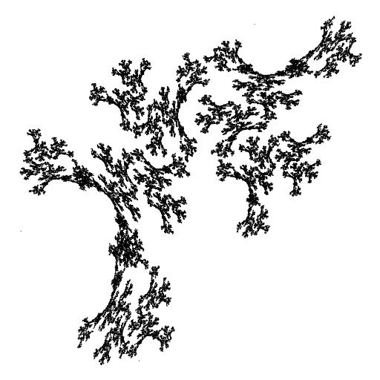
Image sources
https://openclipart.org/detail/25617/astrid-graeber-adult-by-anonymous-25617
https://openclipart.org/detail/169320/girl-head-by-jza
https://openclipart.org/detail/191873/manga-girl---true-svg--by-j4p4n-191873
Image sources
http://commons.wikimedia.org/wiki/File:Babbages_Analytical_Engine,_1834-1871._(9660574685).jpg
http://commons.wikimedia.org/wiki/File:Charles_Babbage_1860.jpg
http://commons.wikimedia.org/wiki/File:John_Tukey.jpg
http://commons.wikimedia.org/wiki/File:Andrew_Apple_(FloC_2006).jpg
http://commons.wikimedia.org/wiki/File:Hubble's_Wide_View_of_'Mystic_Mountain'_in_Infrared.jpg
Image sources
http://commons.wikimedia.org/wiki/File:KnuthAtOpenContentAlliance.jpg
http://commons.wikimedia.org/wiki/File:Pourbus_Francis_Bacon.jpg
http://commons.wikimedia.org/wiki/File:Frans_Hals_-_Portret_van_René_Descartes.jpg
http://commons.wikimedia.org/wiki/File:John_Stuart_Mill_by_London_Stereoscopic_Company,_c1870.jpg
Image sources
http://commons.wikimedia.org/wiki/File:FEMA_-_2720_-_Photograph_by_FEMA_News_Photo.jpg
http://pixabay.com/en/lab-research-chemistry-test-217041/
http://upload.wikimedia.org/wikipedia/commons/2/28/Cut_rat_2.jpg
http://pixabay.com/en/view-glass-future-crystal-ball-32381/

Slide 80
11. Performance
The challenge
Empirical analysis
Mathematical models
Doubling method
Familiar examples
Adopted and modified from Slides by Sedgewick and Wayne

Slide 81
11. Performance
1.1–1.2

